Slide 1
Conceptual Framework, Institutional Arrangements and Data Sources
Habib Khan (khan39@un.org) United Nations Statistics Division
Notes:
1

Slide 2
Conceptual framework
General guidelines
It is recommended that all goods that add to or subtract from a country's stock of material resources by entering (imports) or leaving (exports) its economic territory are recorded in IMTS.
Monetary value
Physical quantity
HS subheading
Partner country
Mode of transport
Goods -> physical, produced objects, over which ownership rights can be established and whose ownership can be transferred from one institutional unit to another.
Economic territory -> (not necessarily contiguous) area under the effective economic control of a single government (BPM 7).

Slide 3
Conceptual framework
General guidelines: time of recording
Time of recording: it is recommended that goods be recorded at the moment they enter or leave a country’s statistical territory.
Lodgement date of customs declaration.
Date of arrival or departure of the goods carrier (in case of early/late clearance).
Change of ownership criterion (instead of time of recording): for goods that add to or subtract from a country’s stock of material resources without entering or leaving.

Slide 4
Conceptual framework
General guidelines: domestic and foreign goods (NEW)
It is recommended that "domestic goods" be defined as those originating within a country's economic territory
Either wholly obtained or produced, or having undergone substantial transformation
Sourced from areas such as free circulation areas, industrial free zones, or premises for inward processing
Goods from customs warehouses or commercial free zones are NOT considered domestic (since no production or substantial transformation)

Slide 5
Conceptual framework
General guidelines: imports and exports
Imports
Imports of foreign goods, including from outward processing (if change in origin)
Re-imports of domestic goods in the same state as they were previously exported. Recommended to be included but separately identified. Should exclude:
Goods withdrawn after temporary dispatch without prior recording as exports
Domestic goods that have undergone processing altering their origin from domestic to foreign (therefore imports of foreign goods)
Exports
Exports of domestic goods, including from inward processing (if change in origin)
Re-exports of foreign goods without undergoing any substantial transformation from their original imported state. Recommended to be included but separately identified. Should exclude:
Goods temporarily admitted without prior recording as imports
Foreign goods that have undergone processing altering their origin from foreign to domestic (therefore exports of domestic goods)

Slide 6
Conceptual framework
General guidelines: non-observed trade (NEW)
Non-observed trade: trade flows that should be captured but may not be for various reasons.
Movements of legal goods carried out informally (informal cross-border trade).
Goods that should be recorded based on the change of ownership.
Trade that falls below the customs or statistical threshold.
Trade at non-digitized borders.
Countries are encouraged to estimate and include these flows if economically significant.
Countries are encouraged to progressively develop their data collection and/or estimation procedures and to collaborate with BOP compilers to ensure data consistency.
May not always be feasible to capture comprehensive details.
It is acceptable to report total exports and imports without a detailed breakdown.

Slide 7
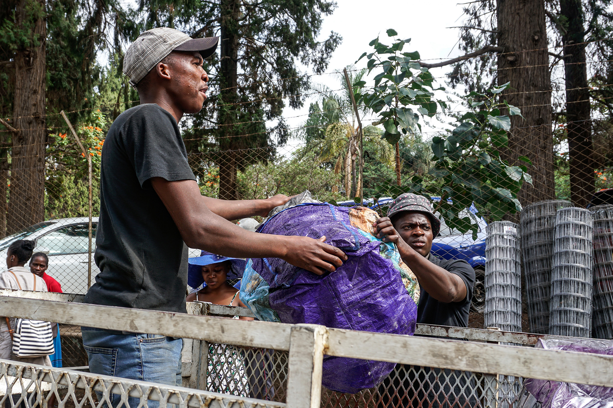
Conceptual framework
Specific guidelines: inclusions (selected items)
Non-monetary gold
Coins made of precious metals (NEW)
Humanitarian aid
Goods for military use
Goods acquired by travellers, if significant (includes shuttle trade) (CLARIFICATION)
Media, whether or not recorded (CLARIFICATION)
Goods for processing with or without change of ownership.
Returned goods (as re-exports or re-imports)
Electricity, gas, oil and water.
Digitally ordered goods (CLARIFICATION)
Ships and aircraft, Satellites and their launchers (change of ownership) (CLARIFICATION)
Waste and scrap with positive commercial value (CLARIFICATION)
Legal goods entering or leaving a country's economic territory illegally/informally (ICBT) (NEW)
Notes:
Gold to which the monetary authorities (or others who are subject to the effective control of the monetary authorities) have title and is held as reserve assets
Humanitarian: recording comprehensive details on commodity classification and partner country for this trade may generate excessive effort, so it is acceptable to report total exports and imports without a detailed breakdown. However, if the trade involves significant commodities, such as lightweight and high value goods (e.g. medicine), these should be recorded in IMTS with full details
(a) goods are purchased in a country by non-resident travellers who transport them to their home country for resale; or (b) goods are acquired by travellers in their home country for resale abroad.
Goods on consignment. These are goods intended for sale but not sold at the time of crossing border. Goods on consignment should be clearly distinguished from those only in transit through a country or those temporarily admitted or withdrawn
Media, whether or not recorded. These goods should be included in IMTS at their full transaction value, provided they are non-customized products stored on physical media (e.g. DVDs, CDs) and come with a perpetual-use license requiring a one-time payment.
Goods for processing refer to those sent abroad or brought into a country under a specific arrangement to undergo a manufacturing transformation that alters their characteristics. Additionally, goods for processing are a key input for compiling ‘manufacturing services on inputs owned by others
countries are encouraged to separately measure or estimate digitally ordered goods that fall below these customs thresholds

Slide 8
Conceptual framework
Specific guidelines: exclusions (selected items)
Goods simply being transported through a country (in-transit/transshipment)
Goods temporarily admitted or dispatched
Monetary gold
Non-financial assets, whose ownership is transferred from residents to non-residents without crossing borders
Goods treated as part of trade in services
De-minimis
Newspaper (direct subscription)
Trade with foreign govt. enclaves within compiling country
Customized software, fixed-term license software
Goods under merchanting
Goods lost or destroyed
Goods produced through additive manufacturing (3D printing) (NEW)

Slide 9
Conceptual framework
Specific guidelines: exclusions but separately recorded
Goods for repair or maintenance (CLARIFICATION)
Waste and scrap with no or negative commercial value
Illegal goods
Goods lost or destroyed
Notes:
Repair: These activities do not constitute substantial transformation or result in the production of a new good

Slide 10
Institutional arrangements
Institutional arrangements
What
In the context of IMTS, institutional arrangements refer to a set of agreements that define the division of the responsibilities among agencies involved in the collection, compilation and dissemination of IMTS data.
Who
Data providers
Data producers
Data users
Which
National statistical offices
Customs administrations
Central banks
Others (e.g. Ministry of Trade)
How
Legal framework (e.g. customs law, statistical law)
Data sharing agreements (scope, format, schedule)

Slide 11
Institutional arrangements
(NEW) Effective institutional arrangements
Long-term commitment among institutions.
Clearly defined rights and responsibilities for all institutions to prevent misunderstandings, duplication, or omission.
Arrangements among the agencies involved that ensure permanent access to data and facilitate consultations and revisions.
Designation of a single agency for dissemination of IMTS.
Formalized working arrangements between the agencies complemented by informal agreements.
Terms of cooperation to ensure that any changes affecting data compilation can be addressed in close collaboration.
Notes:
*establishment of formalized working arrangements between the agencies involved, including agreements on holding inter-agency working meetings, as needed, on granting the access to microdata collected by those agencies and on adhering to requirements on confidentiality
*Terms of cooperation that are set out in a legal document to ensure that any changes to administrative procedures, IT infrastructure or statistical processes affecting data compilation can be addressed in close collaboration

Slide 12
Institutional arrangements
Non-binding arrangements
(NEW) According to the UN Guidance and Templates for Developing a Memorandum of Understanding, the following steps are recommended for developing and maintaining an MOU:
Assemble a team of experts to develop the MOU.
Review the relevant legal frameworks and regulations to assess the extent to which they permit data access or exchange.
Map the current availability and quality of administrative data held by the data provider.
Define the key elements that should be included in the MOU based on the previous steps.
Establish monitoring and feedback mechanisms.

Slide 13
Institutional arrangements
Institutional arrangements
As a matter of high priority, it is recommended to establish institutional arrangements to ensure the compilation of high-quality IMTS and to periodically evaluate their effectiveness.
National agency responsible for the overall IMTS compilation should periodically review the definitions, methods, and trade statistics to ensure alignment with relevant international recommendations and recognized good practices.
When statistical agencies establish institutional arrangements required for producing IMTS, it is recommended to adopt the Generic Statistical Business Process Model (GSBPM) as a standardized framework for statistical production.

Slide 14
Data sources
Customs data
It is recommended that compilers use customs data as the primary and preferred data source for IMTS.
Increasingly, customs data alone are no longer adequate to achieve full and timely coverage of IMTS. Countries are therefore encouraged to review their current data collection and compilation practices and to develop a long-term strategy.
It is recommended that IMTS compilers collaborate closely with customs authorities to ensure the correct and consistent application of CPCs.
It is recommended that information about the customs procedures applied to individual transactions be included in the dataset provided.
IMTS compilers should collaborate with customs authorities to access other supporting documents (e.g. commercial invoices, transport documents, import licenses, certificate of origin).
It is essential that IMTS compilers are fully aware of the actual coverage of customs data and, where necessary, supplement it with additional sources (e.g. electricity, gas, oil, ships and aircrafts).

Slide 15
Data sources
Non-customs data
It is recommended that customs-based data be supplemented, where necessary, with information from alternative sources or through estimation, to ensure full coverage.
It is also recommended to substitute customs data with non-customs sources only when such sources improve data quality in a cost-effective way.
Non-customs sources may include:
Other administrative data (electricity, gas, oil, water)
Systems designed for customs union (e.g. EU Intrastat)
ICBT surveys
Enterprise or household surveys (e.g. digital trade)
Postal records
Ships and aircrafts movement tracking databases (e.g. AIS, ADSB)
Notes:
*Systems such as the Automatic Identification System (AIS) for vessels and Automatic Dependent Surveillance-Broadcast (ADSB) for aircraft enable real-time monitoring of global transport movements

